Slide 1
PROJECT REVIEW – 2
Explainable Vision-Language
Diagnostic Assistant
for Chest Radiographs with Offline Rural Deployment
P. Kavya Sai – 2420030322
D. Poojitha – 2420030697
P. Meghana – 2420030401
S. Anajana – 2420030499
Cluster – 3
Section-7
Faculty: Dr. K Swanthana
NLP Specialization Capstone Project

Slide 2


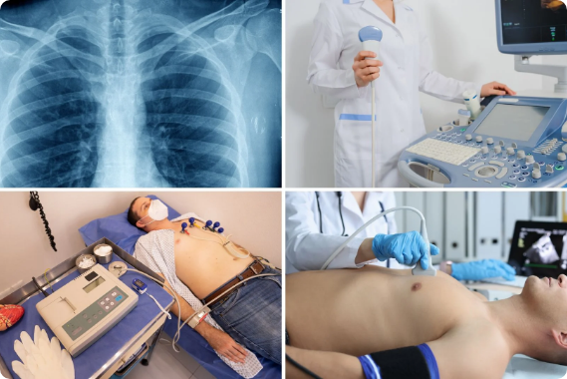
Problem Statement
Acute Radiologist Shortage: Primary health centers in rural regions lack specialist radiologists to read X-rays and detect conditions like pneumonia or tuberculosis.
.
Diagnostic Delays & Travel Burden: Patients travel vast distances to urban hospitals, delaying time-critical care and incurring heavy financial expense.
Black-Box AI Mistrust: Traditional AI systems provide class outputs without explanations, making local nurses reluctant to rely on machine predictions.

Slide 3






Project Objectives
1. Multimodal Diagnosis
2. Visual Explanation
Develop a vision-language assistant to generate plain-language diagnostic descriptions (e.g., "early signs of pneumonia") alongside class confidence scores.
Incorporate Grad-CAM heatmaps and attention overlays that circle the exact anatomical regions of concern, giving healthcare workers verifiable proof.
3. Automated Triage & Priority Guidance
Compute case urgency flags (e.g., "Please refer to specialist within 24 hours") so rural health workers can prioritize critical emergency cases immediately.

Slide 4


Literature Survey & Research Gap
Literature Survey (Existing Work)
Identified Research Gaps
Standard CNN Classifiers: ResNet & DenseNet models achieve strong classification accuracy on ChestX-ray14 but lack report generation capabilities.
Absence of Explainable Multimodal Grounding: Existing systems rarely combine textual diagnostics with exact visual heatmap verification.
Large Vision-Language Models: Heavy Transformer architectures generate clinical reports but require GPU servers and stable cloud APIs.
High Computational Overhead: Complete absence of quantized, offline-capable vision-language models for edge smartphone hardware.
Standalone Saliency Maps: Heatmap tools highlight regions but fail to explain clinical severity or provide actionable triage advice.
Lack of Actionable Triage Systems: Standard models output probabilities without translating them into emergency referral timelines for health workers.
Dataset | Resource URL | Key Details
ChestX-ray14 | NIH CC Box | 112,120 chest X-rays with 14 disease labels.
OpenI (OpenAccess) | NLM OpenI | 7,470 X-rays paired with clinical radiology reports.
ROCO Medical | GitHub / ROCO | Multimodal radiology dataset for text-image alignment.

Slide 5
01 — APPROACH
Methodology
DS
TL
CB
Data-Driven Class Selection
Frozen-Backbone Transfer Learning
Imbalance-Aware Training
11 of 14 NIH conditions retained, chosen by measured per-class support
ImageNet-pretrained ViT-B/32 & DenseNet121; only final blocks fine-tuned
Weighted loss + best-checkpoint-by-F1 to counter overfitting
TT
RA
XC
Post-Hoc Threshold Tuning
Retrieval-Augmented Reporting
Independent Cross-Checks
Per-class PR-curve optimization — no retraining required
TF-IDF grounding in real OpenI radiology report text
Zero-shot CLIP + BLIP v1 as secondary, separate signals

Slide 6
02 — ARCHITECTURE
System Design
1
2
3
4
5
Upload
Classify
Explain + Report
Triage
Deliver
→
→
→
→
Chest X-ray
(PNG / JPG)
ViT-B/32
11-condition model
Attention heatmap +
TF-IDF retrieval
Rule-based
urgency scoring
Streamlit UI +
PDF export
Two independent branches — vision explainability and text reporting — recombine at the presentation layer, alongside supplementary CLIP and BLIP v1 cross-checks.

Slide 7
03 — STACK
Modern Tools and Technologies
Py
HF
SK
CV
PyTorch / torchvision
HuggingFace
Transformers
scikit-learn
OpenCV
Model definition & training
CLIP & BLIP v1
TF-IDF, PR-curves, metrics
Heatmap overlay & contours
PD
ST
PDF
KG
pandas
Streamlit
fpdf2
Kaggle / kagglehub
Dataset & report handling
Interactive web app
Downloadable PDF reports
Dataset acquisition

Slide 8
04 — CODE STRUCTURE
Implementation
Pipeline Stages
Key Files & Purpose
Data → dataset.py, count_labels.py
model.py / train.py
ViT-B/32 transfer learning + imbalance-aware training
Model → model.py, train.py
gradcam.py
Explainability → gradcam.py
Attention-based explainability, heatmap & contour marking
report_generator.py
Evaluation → evaluate.py, tune_thresholds.py
Multi-condition, retrieval-grounded report text
Reporting → report_index.py, report_generator.py
triage.py
Deterministic urgency scoring
Cross-checks → clip_verify.py, blip_caption.py
clip_verify.py / blip_caption.py
Decision → triage.py
Independent CLIP & BLIP v1 cross-checks
Delivery → inference.py, report_pdf.py, app/app.py
app.py / report_pdf.py
Streamlit UI + downloadable PDF report

Slide 9
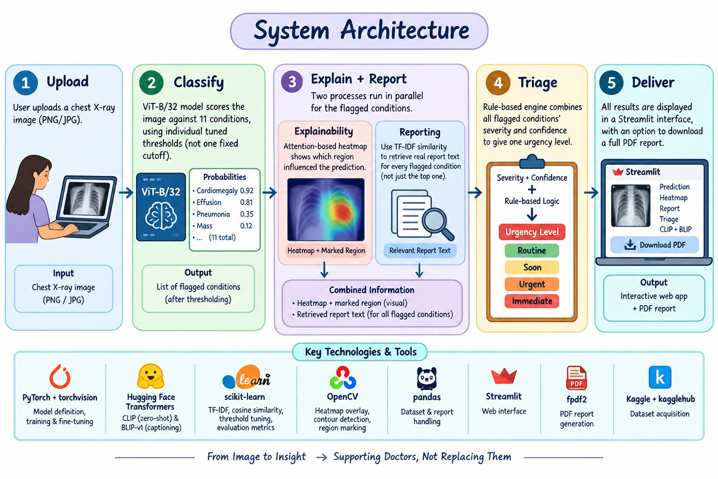

Slide 10
05 — OUTCOMES
Results
11
0.304
7,426
Conditions Classified
Best Macro F1 (tuned)
Real Reports Indexed
Backbone Comparison — Macro F1 Score
Why ViT scored slightly lower
Vision Transformers lack the built-in locality and translation-invariance biases CNNs have, so they typically need more training data to match CNN performance. With only ~4,800 training images, this gap is an expected, well-documented outcome — not an implementation defect.

Slide 11
06 — DEEPER ANALYSIS
Performance Evaluation
Recall Improvement from Per-Class Threshold Tuning
Explainability Validation
0.000 → 0.277
Heatmap std. deviation: gradient-based Grad-CAM (collapsed) vs. attention-based visualization (real signal)
Grad-CAM, adapted from CNNs, collapsed on this ViT due to token homogenization in the mostly-frozen backbone. Attention-based visualization — the standard ViT approach — restored genuine spatial signal.
Trade-off accepted deliberately: for a triage tool, a missed finding is worse than a false alarm.
Qualitative validation: on a held-out case (ground truth: Cardiomegaly, Edema, Effusion), the system correctly flagged Cardiomegaly at 99.9% confidence and Effusion after the multi-condition reporting upgrade.

Slide 12
Thank You
Questions & Discussion
Our project aims to bridge the rural diagnostic gap by delivering an honest, explainable, and fully offline AI assistant — ensuring patients receive timely and safe care regardless of geographic limitations.
Explainable Vision-Language Diagnostic Assistant — Project Review-2

